Slide 1


K.RAMAKRISHNAN COLLEGE OF TECHNOLOGY
(AUTONOMOUS), TRICHY
QUIZ GAME
PRESENTED BY
2303811714821058 – B.R.VIMAL AANANTH
Notes:
1

Slide 2
PRESENTATION OVERVIEW
Problem Identification
Objective
Proposed system
Block diagram of proposed system
Architecture Diagram
Data structures used
Modules
Module Implementation
Module Description
Source Code
Screenshot
Conclusion and Future Enhancement
Notes:
2

Slide 3
PROBLEM IDENTIFICATION
Scope Definition: The problem involves developing a basic quiz game that can be expanded with additional features like more questions, timers, and feedback mechanisms. This scope is well-defined and focused on creating a foundational quiz application.
User Interaction: The game aims to engage users through multiple-choice questions, where users select answers and receive immediate feedback. This interaction is clear and aligns with typical quiz game behavior.
Feature Expansion: The problem identifies potential future enhancements, such as adding timers to questions and implementing scoring systems. These expansions indicate a forward-looking approach to building a more robust and interactive quiz platform.
Educational Potential: While not explicitly stated, the problem implies that the quiz game could serve educational purposes based on the content of the questions provided. This potential adds value to the game beyond mere entertainment.

Slide 4
OBJECTIVE
Foundational Development: The primary objective is to create a simple yet functional quiz game that can serve as a starting point for more advanced features and expansions. By focusing on the basics initially, the objective is to establish a solid structure that can support future enhancements and modifications.
Scalability and Customization: Another objective is to design the quiz game in a modular and scalable way. This approach allows for easy integration of additional features like timers, scoring systems, and a larger pool of questions. The goal is to build a flexible system that can adapt to different requirements and user preferences.

Slide 5
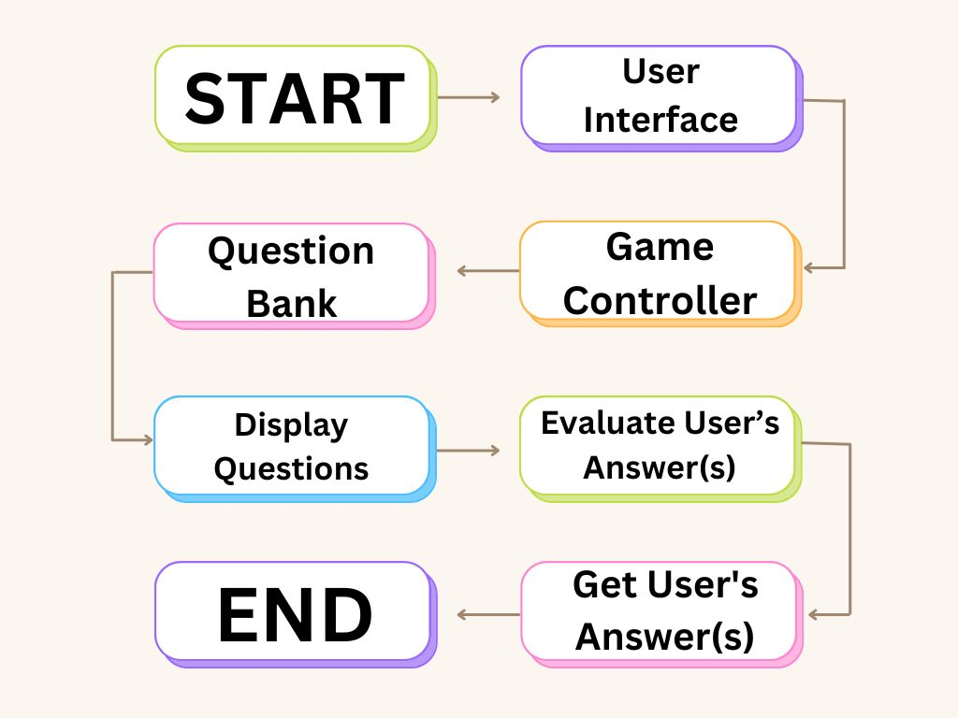
PROPOSED SYSTEM
BLOCK DIAGRAM

Slide 6
ARCHITECTURE DIAGRAM

Slide 7
DATA STRUCTURES USED
Questions Data Structure (List of Dictionaries):
Each question in the quiz is represented as a dictionary containing:
text: The text of the question.
options: A list of multiple-choice options.
answer index: The index of the correct answer within the options list.
User Answers Data Structure (List of Integers):
As the user progresses through the quiz, their selected answers are stored in a list. Each element in the list represents the index of the option chosen by the user for each corresponding question.
Result Data Structure (Scoring System - Integer):
This data structure can be used to store and compute the user's score based on their answers. It keeps track of how many questions the user answered correctly.

Slide 8

Modular Design: The system is designed in a modular way, allowing for easy expansion and addition of new features without major restructuring.
Scalability: The basic structure can be enhanced with features like timers, scoring mechanisms, and more questions as needed.
User Engagement: Immediate feedback and interactivity enhance user engagement and provide a more enjoyable experience.
Educational Value: Depending on the content of the questions, the game can serve as an educational tool for learning and testing knowledge.

Slide 9
MODULE IMPLEMENTATION
Functionality and Scope: The quiz game module presents multiple-choice questions to the player, who must select the correct answer from four options. The module tracks the player's score and provides immediate feedback after each question. A 60-second timer is included to limit response time, adding urgency to the game.
User Interaction and Experience: Players are shown a question with four answer options and must respond within 60 seconds. Immediate feedback is provided, indicating whether the answer was correct and displaying the correct answer if not. The score updates in real-time, and the final score is shown at the end of the quiz.
Technical Design and Implementation: The module uses a Question data structure to store question text, answer options, and the correct answer. The main game loop iterates through the questions, calling the ask Question function for each one. This function handles user input, timing, and score updating. A timer function ensures accurate timing for each question. The design allows for easy expansion by adding more questions or modifying existing ones.
Notes:
9

Slide 10
MODULE DESCRIPTION
Capability and Functionality: The quiz game module facilitates the creation and execution of interactive quizzes with multiple-choice questions. It manages the presentation of questions, collects user responses, and provides immediate feedback on correctness. The module includes a timer feature to enforce time limits on each question, enhancing the challenge and engagement of the game.
Scalability and Customization: Designed for scalability, the module allows for easy expansion by accommodating a variable number of questions and options. It supports customization of quiz content, enabling users to define new questions, options, and correct answers as needed. This flexibility makes the module suitable for a wide range of educational and entertainment purposes.
User Interaction and Integration: Interaction with the quiz game module is straightforward, with clear prompts and intuitive response mechanisms. Integration into larger applications or systems is seamless, as the module can be easily incorporated into existing codebases or frameworks. Its modular design facilitates integration with graphical user interfaces (GUIs) or other user interaction components for enhanced usability.
Notes:
10

Slide 11
SOURCE CODE
#include <stdio.h>
#include <stdlib.h>
#include <string.h>
#include <time.h>
#include <ctype.h>
#define MAX_QUESTIONS 5
#define MAX_LENGTH 100
#define TIME_LIMIT 60 // Time limit set to 60 seconds (1 minute)
typedef struct {
char question[MAX_LENGTH];
char options[4][MAX_LENGTH];
char correctOption;
} Question;
void askQuestion(Question q, int *score);
void timer(int seconds);
char toLowerCase(char ch);
Notes:
11

Slide 12
SOURCE CODE
int main() {
Question questions[MAX_QUESTIONS] = {
{"What is the capital of France?", {"A. Berlin", "B. Madrid", "C. Paris", "D. Rome"}, 'c'},
{"What is 2 + 2?", {"A. 3", "B. 4", "C. 5", "D. 6"}, 'b'},
{"What is the largest planet in our solar system?", {"A. Earth", "B. Mars", "C. Jupiter", "D. Saturn"}, 'c'},
{"Who wrote 'To be, or not to be, that is the question'?", {"A. Dickens", "B. Shakespeare",
"C. Hemingway", "D. Austen"}, 'b'},
{"What is the smallest prime number?", {"A. 1", "B. 2", "C. 3", "D. 5"}, 'b'}
};
int score = 0;
for(int i = 0; i < MAX_QUESTIONS; i++) {
askQuestion(questions[i], &score);
}
printf("Quiz finished! Your final score is %d/%d.\n", score, MAX_QUESTIONS);
return 0;
}
Notes:
12

Slide 13
SOURCE CODE
void askQuestion(Question q, int *score) {
char userAnswer;
time_t start, end;
printf("%s\n", q.question);
for(int i = 0; i < 4; i++) {
printf("%s\n", q.options[i]);
}
printf("You have %d seconds to answer: ", TIME_LIMIT);
time(&start);
timer(TIME_LIMIT);
if(scanf(" %c", &userAnswer) == 1) {
time(&end);
double elapsed = difftime(end, start);
if(elapsed > TIME_LIMIT) {
printf("Time's up! Moving to the next question.\n");
} else if(toLowerCase(userAnswer) == q.correctOption) {
printf("Correct!\n");
Notes:
13

Slide 14
SOURCE CODE
(*score)++;
} else {
printf("Incorrect! The correct answer was '%c'.\n", q.correctOption);
}
}
}
void timer(int seconds) {
int milliseconds = 1000 * seconds;
clock_t start_time = clock();
while(clock() < start_time + milliseconds);
}
char toLowerCase(char ch) {
if (ch >= 'A' && ch <= 'Z') {
return ch + ('a' - 'A');
}
return ch;
}
Notes:
14

Slide 15
SCREENSHOT
Notes:
15

Slide 16
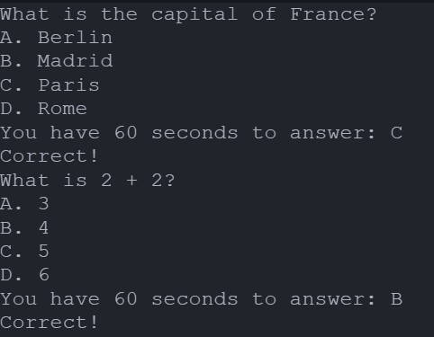
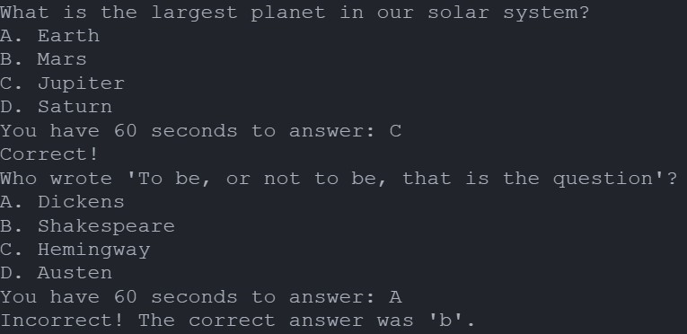
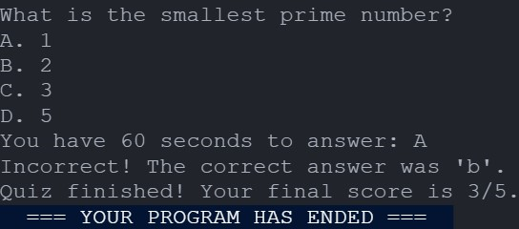
SCREENSHOT
Notes:
16

Slide 17
CONCLUSION AND FUTURE ENHANCEMENT
Conclusion: This basic implementation of a quiz game in C demonstrates how to present multiple-choice questions to users, accept their answers, and provide immediate feedback. The inclusion of a timer adds a layer of challenge by limiting the time available to answer each question to 1 minute. The toLowerCase function ensures case-insensitive comparison of answers.
Future Enhancements:
Graphical User Interface (GUI): Implement a GUI using libraries such as GTK+ or ncurses to make the game more interactive and visually appealing.
Question Categories: Allow users to select categories or difficulty levels for the questions.
Advanced Scoring System: Introduce a more complex scoring system that awards points based on the speed of response or difficulty of the question.
Leaderboard: Implement a leaderboard to display high scores and encourage competition among players.
Save and Load Functionality: Enable saving and loading of quiz states so players can pause and resume games.
Randomized Questions: Randomize the order of questions each time the quiz is played to enhance replayability.
Audio Feedback: Provide audio feedback for correct and incorrect answers, as well as for timing out.
Question Pool Expansion: Continuously expand the pool of questions to keep the game fresh and challenging.
This modular approach allows for easy addition of new features and improvements, making the quiz game a versatile and engaging educational tool.
Notes:
17

Slide 18
THANK YOU
Notes:
18

